Slide 1
Continuous Improvement
WP2 T3

Slide 2
Learning Objectives
Devise a new version of the learning materials
Collaborate with external parties

Slide 3
Agenda
Feedback analysis
New version
Co-creation

Slide 4
Identify elements for improvement
Sources:
feedback form
external QA recommendations
self-reflection after training
GitHub issues
gathered comments from external contributors
direct mail contact
any other means of communication (e.g. feedback from workshops, discussions, team meetings, etc.)
Gather
Analyse
Create a list of potential improvements with impact level (high, moderate, low)
Decide which will be addressed in a new version
Work incrementally
Multiple cycles may be required

Slide 5

New Iteration
Create list of changes
Organise the work
Restart from Design/Produce
Re-publish with new version number
Verify

Slide 6
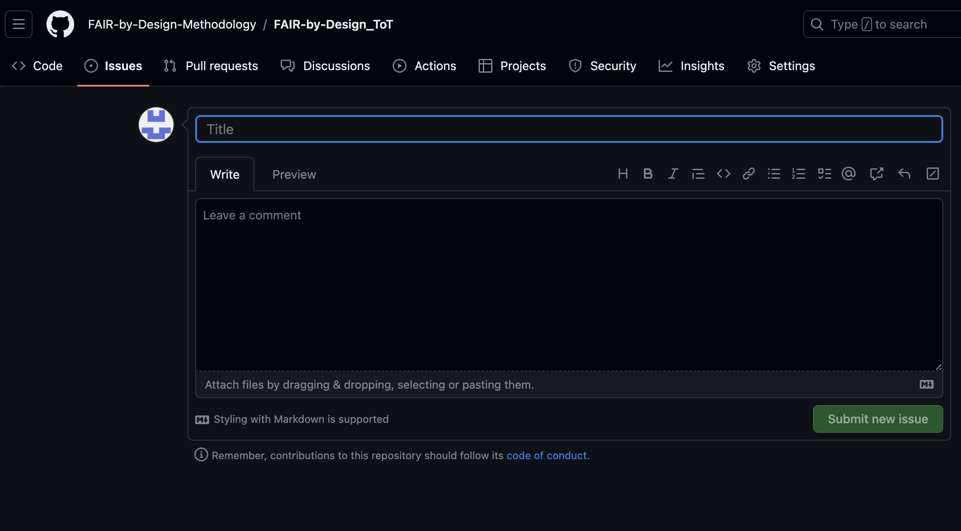
External parties and co-creation
GitHub Issues
Added as contributor
Use fork and pull workflow

Slide 7
Summary
Learning materials can always be improved and their content should be kept up-to-date.
Analyse the identified improvement points, decide what to implement in a new version and go back through the methodology stages.
You are not alone on the continuous improvement journey!

Slide 8
End of the road…
You are not alone!
T2.3 is here to support you on your FAIR-by-Design journey
May your creativity flow and all your learning materials be FAIR!!!
Please fill out the feedback form and help us improve!

Slide 9
Postcard from a Friend
Give your 5 cents to future training participants via the assignment…

Slide 10
Thank you! Any final questions?
sonja.filiposka@finki.ukim.mk
Cite instructions on: https://doi.org/10.5281/zenodo.12604767

